Slide 1
Bienvenue au cours de Français!
Welcome to French Class!

Slide 2
Je suis Madame Lecerf.
Bonjour ! I am Ms. Lecerf.
I will be teaching French 3 & 1 this semester.
alecerf@paulding.k12.ga.us
770-445-5100 ext 29610 phone
Please feel free to call or email me with any questions!

Slide 3
EPHS SCHEDULE OF FRENCH CLASSES 1er bloc ➔ Français III 2e bloc ➔ Préparation 3e bloc ➔ Français I 4e bloc ➔ Français I
All students will have a WWW.VHLCENTRAL.COM account where they have a Virtual Textbook, flashcards, tutorials, videos and activities. This is an AWESOME resource! Please take advantage of it!
French 3 Students use D’accord 2 (Orange) & D’accord 3 (Blue) Textbooks.
French 1 Students use D’accord 1 (Red) Textbook.
Students need to check their CANVAS French tab first daily in ANNOUCEMENTS for information, resources, and assignments and then (2) their VHL account if indicated in the Canvas directions.
Students are responsible for following directions, completing their work & asking any questions. Students are expected to work everyday, STUDY, REVIEW & ASK questions.
Students must put the TIME & ENERGY into learning a foreign language...unfortunately, I cannot do it for the students. If students are not completing their work, not paying attention, &/or on their phones in class, it will be harder for them to understand the information as they are not doing their part.
Stay on target with the classwork as it makes it harder to catch up if students are behind.

Slide 4
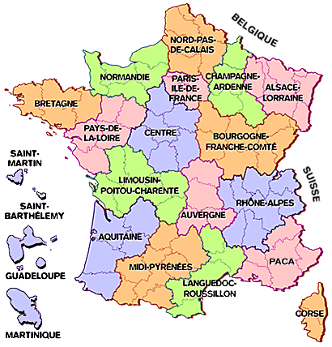
Helpful supplies:
MASKS
Binder with sections/Notebook
Earphones/Earbuds that work with Laptops
Notecards/Index cards (may be cut smaller)
Paper
Pencils/Pens/Markers
Page Protectors (if your papers/hand-outs tear easily)
Come to class prepared to succeed! ☺
Donations of Hand Sanitizer, Wipes and Paper Towels are GREATLY appreciated!
4 Year Colleges/GPA:
If you are planning on going
to a 4-Year College or aspiring to receive
the HOPE Scholarship (or any other scholarship) then any Foreign Language course Grade counts toward your GPA. It is very important to do your best in any FL class.
You need at LEAST 2 Levels of the SAME Foreign
Language to be eligible to apply to a 4-year college. If you are hoping for a scholarship or even if it is a competitive college to get into, then colleges prefer to see students taking as many levels of the same foreign language as possible. It is possible to take multiple foreign languages here at EPHS, but please remember you must have at LEAST 2 Levels
of the SAME Foreign Language.

Slide 5
Teacher Expectations
Students are expected to be RESPECTFUL (speak kindly, follow directions the first time, stay on task, maintain Academic Honesty, be on time to class, etc.).
Students are expected to be responsible for their LEARNING. No one can do the learning for someone else. Students are expected to put in the energy to receive the results they desire.
Personal electronic devices (cellphones, smart watches, tablets, etc.) are not to be out or used during class unless
otherwise stated.

Slide 6
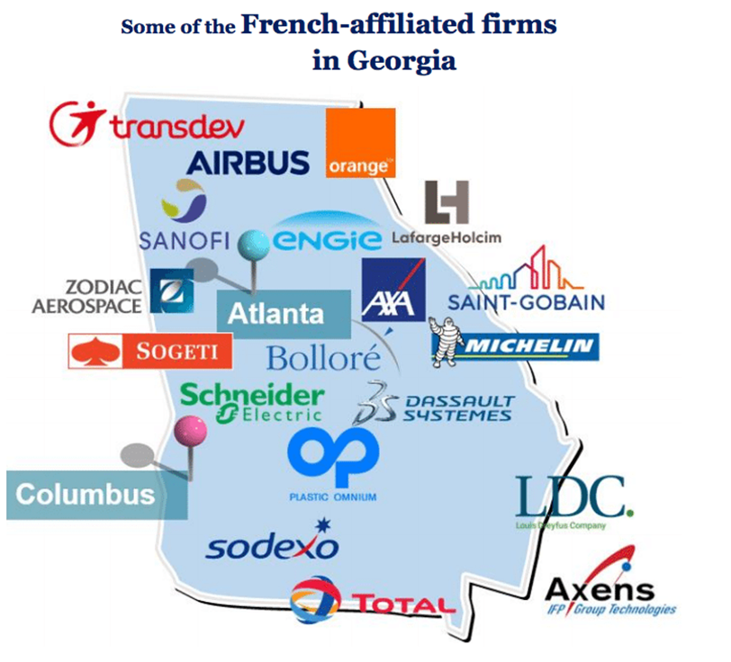
The French Speaking World French is spoken all over the world! After English, French is the second most widely learned foreign language in the world. It is the 5th most widely spoken language in the world! Georgia has many French companies that are always looking for multilingual people!

Slide 7
Tutoring is on Mondays & Tuesdays 8-8:20 & 3:30-4:00, and by Appointment on Fridays (or other days). Please EMAIL me to let me know you are coming & what you need help on specifically! ☺
There are so many reasons why and ways to learn French, so let’have an amazing year! ☺

