Slide 1
Health and Your Wellness
Coach Whitaker

Slide 2
Vocabulary
Lifestyle diseases—disease caused by unhealthy behaviors and other factors.
Risk Factor—anything that increases the likelihood of injury, disease, or health problems.
Sedentary—not taking part of physical activity regularly.
Health—state of well being in which all components of health are in balance.
Value—a strong belief or ideal
Wellness—the achievement of a person’s best in all 6 components of health.

Slide 3
Vocabulary
Life skill—a tool for building a healthy life.
Coping—dealing with problems and troubles in an effective way.
Resource—something that you can use to help achieve a goal.
Consequence—a result of your actions and decisions.
Collaborate—to work together with one or more people.
Peer Pressure—a feeling you should do something because that is what your friends want.
Refusal skills—a strategy to avoid doing something you don’t want to do.

Slide 4
Vocabulary
Self-Esteem—a measure of how much you value, respect, and feel confident about yourself.
Empathy—the ability to understand another person’s feelings, behaviors, and attitudes.
Emotion—feeling that is produced in response to life experiences.
Defense mechanism—an unconscious behavior used to avoid experiencing unpleasant emotions.
Mental illness—an illness that affects a person’s thought, emotions, and behaviors.

Slide 5
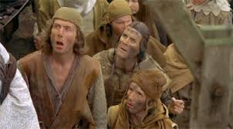
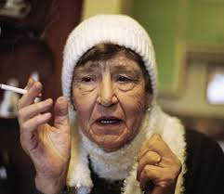
Health Today
Health in the Past: Infectious Diseases
Can be passed from one person to another caused by pathogens such as viruses and bacteria.
Leading cause of death in America in the 1800’s and 1900’s
Health Today: Lifestyle Diseases
Diseases caused by unhealthy factors and other behaviors.
Influenced by the choices you make that affect your health

Slide 6
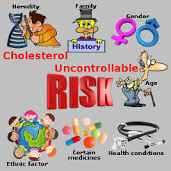
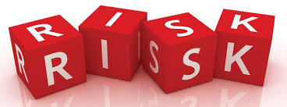
Health Risk Factors
Risk Factor—is anything that increases the likelihood of injury, disease, or other health problems.
Controllable Risk Factors—are risk factors that you can do something about. They are controlled by your behavior—smoking, diet, exercise..
Uncontrollable Risk Factors—risk factors that you cannot change—age, heredity, gender…..
FOCUS on the risk factors you can control (Controllable Risk Factors)

Slide 7
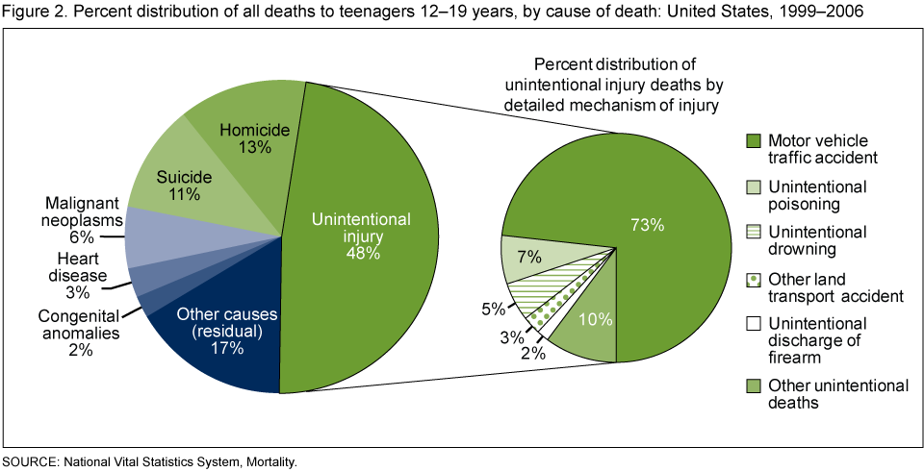
Leading Causes of Teenage Death
In the US:
Motor vehicle accidents
Homicide
Suicide
Other accidents
19-65—leading cause is cancer
Over 65—leading cause is heart disease

Slide 8
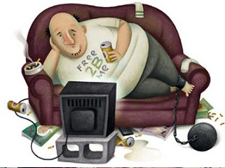
Six Health Risk Behaviors
Sedentary lifestyle—not taking part in physical activity on a regular basis.
Alcohol and other drugs—MAJOR factor in heart disease, cancer, car accidents, physical fights, depression, suicide, STD’s, and mental disorders.
Sexual Activity—outside of a committed relationship puts people at risk-HIV infection, STD’s, pregnancy, and emotional problems.

Slide 9
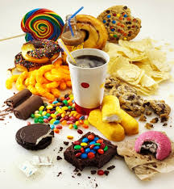
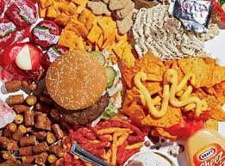
Six Health Risk Behaviors
Behaviors that cause injuries—behaviors that contribute to leading causes of death for teens.
Tobacco Use—single leading preventable cause of death in the US. Major risk factor for heart disease, cancer, and stroke.
Poor Eating Habits—can either increase or lower your chances of developing many diseases.

Slide 10
Activity Choices
Working with a partner, Controllable Risk Factors Table
For—chronic diseases, other life stresses (making parents happy), poor health habits, or risky behavior.
Most Have:
What it is?
Drawing in the middle.
Six controllable risk factors

Slide 11
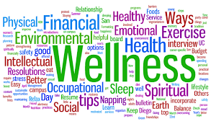
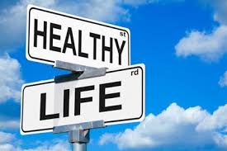
Health and Wellness
What is being Healthy?
More than being physically fit and free from disease.
Health—is state of well-being in which all of the components of health are in balance

Slide 12
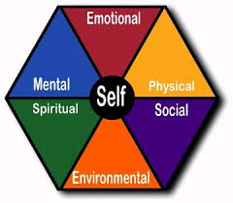
Six Components of Health
Physical Health—refers to the way your body functions—eating right, exercise, being at recommended body weight, and being free of sickness and disease.
Emotional Health—is expressing your emotions in a positive, nondestructive way. Emotionally healthy people can cope with unpleasant emotions and not get overwhelmed by them.
Social Health—is the quality of your relationships with friends, family, teachers, and other you are in contact with.

Slide 13
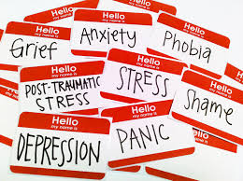
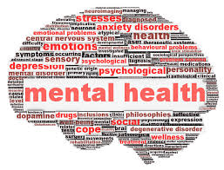
Six Components of Health
Mental Health—is the ability to recognize reality and cope with the demands of daily life. Mental Health is strongly influenced by your emotional health. More than having a mental illness. High self-esteem.
Spiritual Health-is maintaining harmonious relationships with other living things and having spiritual direction and purpose. Purpose or religion.
Spiritual health also includes living to one’s ethics, morals, and values.
Environment Health—is keeping your air and water clean, your food safe, and the land around you enjoyable and safe.

Slide 14
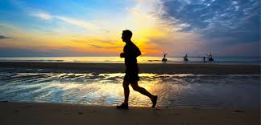
Wellness: Striving for Optimal Health
Wellness-is the achievement of a person’s best in all six components of health
Unrealistic to think a person can do this all the time. It is more of a continuum or a sliding scale.

Slide 15
Influences on Your Wellness
Heredity Influences—traits you inherit from your parents.
Social influences—your health is influenced by the relationships you have with other people.
Cultural influences—culture is the values, beliefs, and practices shared by people that have a common background.
Environmental influences—Your surroundings, the area where you live, and all the things you have contact with are part of your environment.

Slide 16
Activity
Six Components of Health
Concept Map of Six Components of Health with two positive and two negative aspects of each 6 components.
*Make a List of Every Decision You Make in a Day

Slide 17
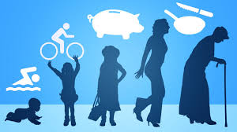
Skills for a Healthy Life
Life skills will help you build a healthy life.
Learning to use life skills will boost your wellness throughout your life.

Slide 18
Ten Life Skills
Assessing your health—helps you to evaluate your health so you know what to improve.
Communicating effectively—teach you good communication skills, which include knowing how to listen and speak effectively.
Practicing Wellness—how to practice healthy behaviors daily so you can have life-long help.
Coping—dealing with troubles or problems in an effective way.
Being a wise consumer—help you make good decisions when buying health products and services.

Slide 19
Ten Life Skills
Evaluating Media Messages—media has a significant influence on how you learn about the world. This skills gives you the tools to analyze media messages.
Using Community Resources—this life skill will help you find these services to provide help to all six components of health.
Making GREAT Decisions--everyone wants to make the right decisions for themselves. Life is about the choices you make.
Using Refusal Skills—provides you with different ways to say no to the things you do not want to do.
Setting Goals—provides help to reach your life goals.

Slide 20
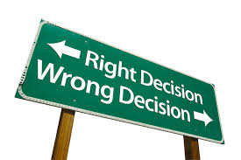
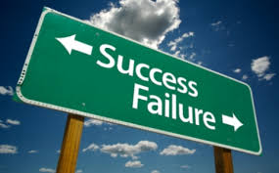
Making GREAT Decisions
You make decisions everyday about EVERYTHING everyday.
Making decisions is important because YOU are responsible for the consequences of your decisions.
Consequences are the results of your actions and decisions.
Seek advice and collaborate important decisions with your parents or someone you trust.

Slide 21
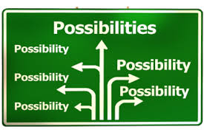
Making GREAT Decisions Model
G—Give thought to the problem
Pause and think before giving an impulsive answer.
R—Review your choices
Helps to think about all choices.
E—Evaluate the consequences of each choice
Weigh the pros and cons of each choice.
A—Assess and choose the best choice
Make the choice. Your values have a big effect on your decision making.
T—Think it over afterward
Reflect on the choice.

Slide 22
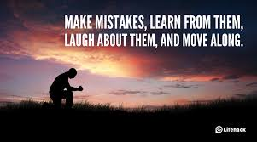
Everyone Makes Mistakes
You will make mistakes—Make up for them!!!
If you make a poor decision:
STOP—stop and admit that you made a poor decision. When you admit your wrong decision, you take responsibility for it.
THINK—think about someone that you can talk about the problem. Discuss ways to fix the situation.
GO—do your best to correct the situation.

Slide 23
Talking My Baby Self
Give yourself advice on my top ten life survival skills.
Graphic
Act it Out
Speech
Sing or write a song about it.

Slide 24
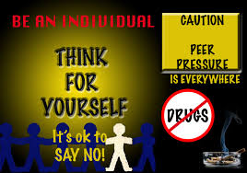
Resisting Pressure From Others
Who influences you?
Peer pressure—is a feeling that you should do something because that is what your friends want.
Your family can also influence your behaviors and decisions.
Media can influences your decisions as well.
Influences can be:
Positive—having positive role models and being influenced to improve yourself.
Negative—being pressured to do something that you don’t want to do.
Consequences of negative pressure can be serious.

Slide 25
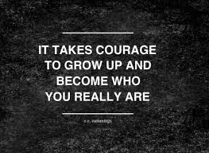
Types of Pressure
Direct Pressure
Indirect Pressure
Pressure that results from someone who tries to convince you to do something that you don’t want to. Examples:
Teasing
Persuasion
Explanations
Put-downs
Threats
Bribery
Pressure that results from being swayed to do something because people you look up to are doing it. Examples:
TV
Radio
Advertising
Role Models
Popular People
Famous People

Slide 26
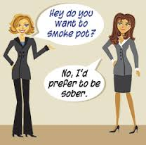
Refusal Skills
A strategy or strategies to avoid doing something you don’t want to do.
Blame someone else
Give a reason
Ignore the request or pressure
Leave the situation
Say NO Thanks
Say no and mean it
Keep saying no
Make a joke of it
Make an excuse
Suggest to do something else
Change the subject
Team up with someone

Slide 27
Refusal Skills Skits

Slide 28
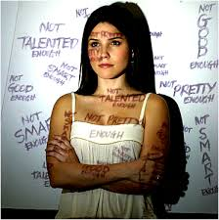
Self Esteem and Mental Health
Benefits of High Self-Esteem
Increased respect (VOICE)—respect themselves by taking care of themselves. Respect your values and beliefs.
Increased ability to reach goals.
Increased willingness to try—have the will to try new things and don’t get discourage easy.
Increased feelings of value—feel they are a valuable part of their family, school, and community
Self Esteem—is a measure of how much you value, respect, and feel confident about yourself. (How you feel about yourself affects everything you do)

Slide 29
Risks of Low Self-Esteem
Risk of Low Self Esteem (More vulnerable to peer pressure)
May not respectful to themselves or others.
Harmful to mental health. Linked to suicide, depression, eating disorders, running away, and violence

Slide 30
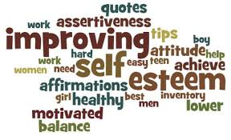
High V Low Self Esteem
High
Low
Speaks up for self
Respects self and others
Tries new things
Feels valuable to society
Adjusts to change
Feels optimistic
Makes decisions based on values
Feels insecure
Disrespects self and others
Vulnerable to peer pressure
Doesn’t feel valuable
Feels depressed
Fears failure
Uses drugs and alcohol
Feels pessimistic
Behaves destructively

Slide 31
Development of Self Esteem
Starts when you are born (Parents)
Self Concept
Measure how someone views themselves
Interpreting Messages From Others
How you interpret messages about yourself has a lot to do how you view yourself.
Negative messages
Can serve as good advice (constructive criticism)
Can be harmful—you have the power to control your self esteem.

Slide 32
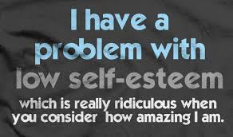
Improving Your Self-Esteem
Use positive self-talk
Control the messages to yourself by coaching yourself.
Act with Integrity
Doing what one knows is right
Don’t let anyone violate your integrity
Choose supportive friends
Avoid friends that are critical, disrespectful, or bring you down.
Accept Yourself
You are not perfect. Accept who you are despite your imperfections.

Slide 33
Promoting Yourself
What are five positive things that you do well?
What is your personality like?
What are three things people would say about you?
Draw yourself and list the answers to these questions.

Slide 34
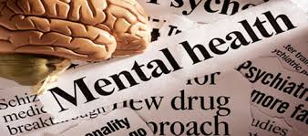
Mental and Emotional Health
Mental Health is the state of mental well being in which someone can cope with the demands of daily life.
People who are mentally and emotionally healthy have the following characteristics:
A sense of control—take charge of their lives.
Ability to endure failures and frustrations—set backs part of learning.
Ability to see events positively—see challenges as opportunities.
Ability to express emotions in a healthy way

Slide 35
Maslow’s Hierarchy of Needs
Self Actualization—achievement of the best that a person can be.
Maslow studied emotions and behaviors.
He believed that people want to reach self actualization.
In order to do so people had to achieve some very basic needs.

Slide 36
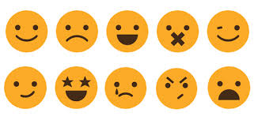
Expressing Emotions
Emotions are the feeling that is produced in response to life experiences.
Emotions are not good or bad.
However, expressions of emotions can have positive or negative effects.
Learning to express your emotions:
Based on how others around you express emotions.
You can learn to express your emotions more constructively regardless of how others around you do.

Slide 37
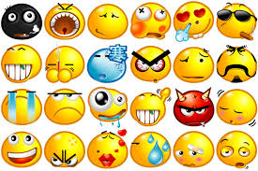
Managing Emotions
Emotions can be overwhelming
Suggestions to help handle them:
Talk it Out
Blow off steam
Be creative

Slide 38
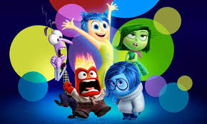
Handling Difficult Emotions
Anger—results from frustration or helplessness. Keep your anger from getting out of control.
Fear—use self-talk instead of thinking about being scared.
Guilt—alerts you that you are behaving in a way that goes against your values. RIGHT THE WRONG
Jealously—caused by fear that something you love or own will be lost.
Loneliness—isolation from others. Join a group, club, or team.

Slide 39
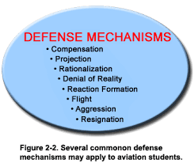
Defense Mechanism
Painful emotions such as fear and guilt can be difficult to cope with.
Defense mechanism is an unconscious thought or behavior used to avoid experiencing emotions.
Each person needs to find the right balance between managing emotions and defense mechanisms.
Some common defense mechanisms
Compensation, Daydreaming, denial, displacement, idealization, projection, rationalization, regression, repression, and sublimation.

Slide 40
Skit with Handling Emotions

Slide 41
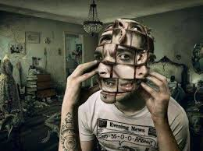
Mental Disorders
Mental Disorders is an illness that affects a person’s thoughts, emotions, and behaviors.
MD people may not be able to have fun.
They may not feel good about themselves.
Struggle at developing intimate relationships
To understand mental disorders, you need to learn their symptoms.

Slide 42
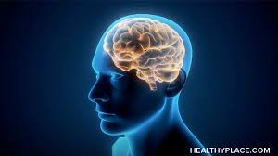
Types of Mental Disorders
There are many types of Mental Disorders with a variety of symptoms. Some of these include:
Too much or too little sleep
Feeling of extreme sadness
Unexplained mood changes
Drug or alcohol
Inability to concentration
Extreme anxiety or irrational fear
Personality changes
False perception of reality

Slide 43
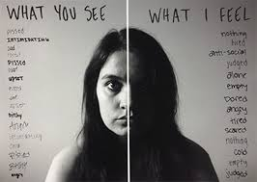
Common Disorders: Depression
Depression is sadness and hopelessness that keep a person from carrying out everyday activities.
Symptoms include: withdrawing from people, lack of energy, loss of appetite or overeating, too much or little sleep, feelings of hopelessness.
Actions of to Take:
Face the problem
Identify the problem (biological or loss or loneliness)
Take Action

Slide 44
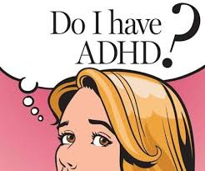
ADHD
A person is frequently inattentive or impulsively hyperactive to the point that he or she has problems accomplishing daily activities.

Slide 45
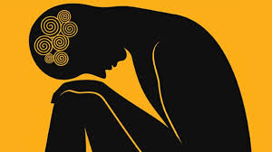
Anxiety Disorders
It is normal to feel nervous or worried but it occurs frequently or if it causes terror it may be an anxiety disorder.
Panic Disorder—the person feels extreme fear for his or her life even though they are not in danger.
Phobias—characterized by excessive or persistent fear of something.
Obsessive Compulsive Disorder—triggered by uncomfortable thoughts and repetitive behaviors.
Other include: PTSD, Eating Disorders, Hypochondria, bipolar disorder, and schizophrenia.

Slide 46
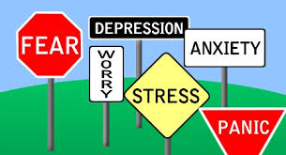
Help For Mental Disorders
Psychotherapy
Counseling from a licensed therapist.
Group Therapy
Counseling in a group with the same disorders.
Medication

