Slide 1
Tobacco, Alcohol, and Illegal Drugs
Coach Whitaker

Slide 2
Vocabulary
Alcohol—the drug in wine, beer, and liquor that causes intoxication
Intoxication—the physical and mental changes produced by drinking alcohol
BAC—amount of alcohol in a person’s blood, expressed as a percentage
Cirrhosis—a deadly disease that replaces healthy liver tissue with scar tissue

Slide 3
vocabulary
Nicotine—the highly addictive drug that is found in all tobacco products
Carcinogens—any chemical or agent that causes cancer
Tar—sticky, black substance in tobacco smoke that coats the inside of the airways and contains carcinogens
Carbon monoxide—a gas that blocks oxygen from getting into the bloodstream

Slide 4
vocabulary
Stimulant—a drug that temporarily increases a person’s energy and alertness
Depressant—a drug that causes relaxation and sleepiness
Opiates—highly addictive drugs that are used as pain relievers and sedatives
Hallucinogen—a drug that distorts perceptions, causing the user to see or hear things that are not real

Slide 5
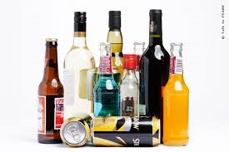
alcohol
Alcohol is the drug found in beer, wine, and liquor that causes __________________________________
Intoxication includes all the physical and mental changes produced by drinking ____________________________________________.

Slide 6
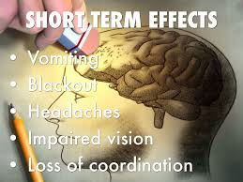
Short term effects of alcohol on the body
Alcohol irritates the mouth, throat, esophagus, and ____________________________________.
Alcohol makes the heart work harder.
Alcohol makes the body lose heat.
Alcohol causes the liver to work harder.
Alcohol causes ______________________________.

Slide 7
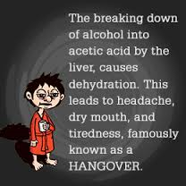
Short effects of alcohol on the mind
Alcohol slows down the nervous system.
The drinker loses _______________________
The drinker cannot focus his or her _____________________.
The drinker may have slurred speech.
The drinker loses coordination and judgment.

Slide 8
Short term effects of alcohol
Blood alcohol concentration (BAC) is the amount of alcohol in a person’s blood expressed as a __________________________________________.
Alcohol has different effects at different BACs.
Binge drinking is the act of drinking five or more drinks in one sitting.
Binge drinking can lead to alcohol poisoning, and can be ________________________________________________________.

Slide 9
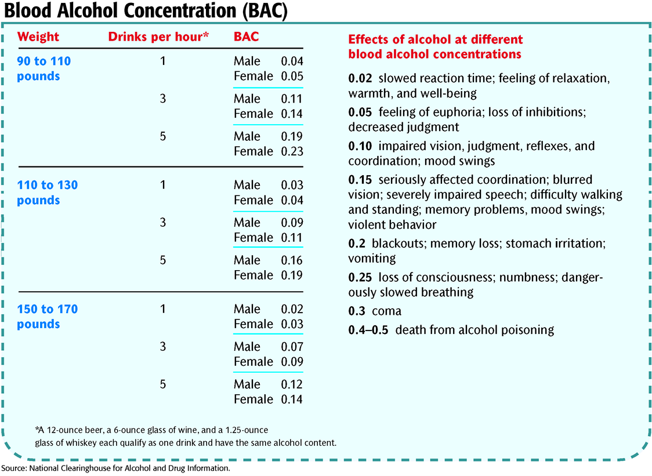

Slide 10
Long term effects of alcohol
Prolonged use of alcohol can damage the heart, blood, liver, kidneys, pancreas, the digestive tract, and the immune system.
Cirrhosis is a disease caused by long-term alcohol use in which healthy liver tissue is replaced with scar tissue.
Alcohol causes permanent changes in the brain due to cell death from dehydration and lack of _____________________________________________________________.
Alcoholism a leading cause of dementia in the __________________________________________________________.

Slide 11
Long term effects of alcohol

Slide 12
Activity
Impaired activities
Walking straight line, finger to nose
Shooting basketball
Kicking a ball
Relay race

Slide 13
Tobacco use—Dangerous effects
Nicotine is the addictive drug found in all tobacco products.
Cigarette smoke contains more than 4,000 chemicals. Of these, at least 40 are _______________________________________________________.
Carcinogens are chemicals or agents that cause _________________________________________________________.

Slide 14
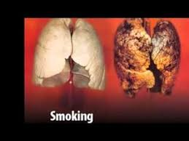
Tobacco use—dangerous effects
Tar is a sticky, black substance in tobacco smoke. Tar contains the following carcinogens:
Cyanide
Formaldehyde
________________________________
Vinyl chloride
Cigarette smoke also contains carbon monoxide, a toxic gas that keeps oxygen from getting into the ____________________________________________________________________

Slide 15
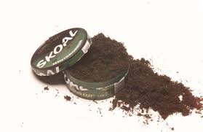
All types are dangerous
Smokeless tobacco products, such as chewing tobacco and snuff (dip), also contain nicotine and _____________________________________________________.
Smokeless tobacco products also contain other carcinogens, such as arsenic, nickel, benzopyrene, and polonium.
Snuff and chewing tobacco lead to mouth sores and oral________________________________________________________.
Pipe tobacco, cigars, and even herbal cigarettes also contain nicotine and tar, and therefore contain a large number of carcinogens.

Slide 16
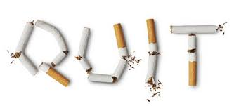
Nicotine is addictive
Like all addictive drugs, nicotine affects the brain and other parts of the body and leads to physical dependence and _________________________________________________________.
Quitting tobacco use is difficult and withdrawal is unpleasant, but the dangerous effects of tobacco are far worse than the trials of __________________________________________________________.

Slide 17
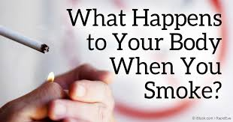
Short term effects
Nicotine has the following short-term effects:
Stimulates the brain reward system
Increases heart rate and blood pressure
Increases breathing rate
Increases blood-sugar levels
Stimulates the vomit _______________________________________________________
Carbon monoxide blocks oxygen from the _________________________________________.
Tar and other chemicals damage the lungs and inside of the mouth.

Slide 18
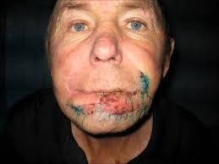
Long term addiction
Long-Term Effects of Tobacco Use
Long-term tobacco use leads to ____________________________________________.
Long-term tobacco use has a number of minor effects, such as stained teeth and fingers and a pervasive smell of ______________________________.

Slide 19
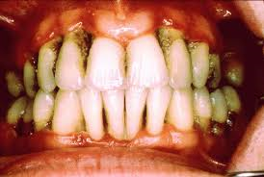
Mouth effects
Long-Term Effects of Tobacco Use
Smoking changes the natural chemical balance inside the mouth, leading to increased plaque, gum disease, and tooth _____________________________________________________.
Tar in tobacco smoke stains ______________________________________________.

Slide 20
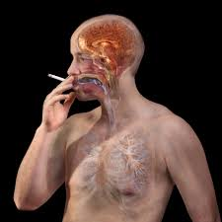
Brain effects
Long-Term Effects of Tobacco Use
________________________________________ reduces oxygen to the brain, narrows blood vessels, and can lead to strokes.
____________________________________________ also changes the brain in ways that lead to addiction.

Slide 21
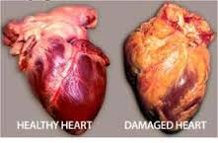
Heart effects
Long-Term Effects of Tobacco Use
Nicotine increases heart rate and blood pressure and narrows the blood _________________________________________________________.
It also increases the risk of hardened and clogged arteries, which can lead to a heart __________________________________________

Slide 22
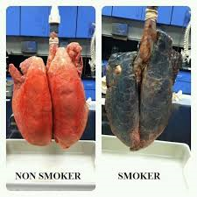
Lung effects
Long-Term Effects of Tobacco Use
Cigarette smoke puts carcinogens directly into the _________________________________________.
It kills the tiny hairs that remove harmful substances from the lungs.
The loss of these hairs increases the risk of _________________________________________, emphysema, and lung cancer.

Slide 23
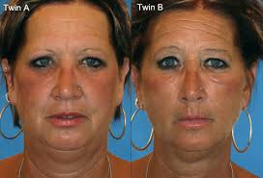
Skin effects
Long-Term Effects of Tobacco Use
Smoking breaks down the proteins that give skin elasticity. This leads to wrinkles and premature aging of the ____________________________________.
_______________________________________ also increases a person’s chances of developing skin cancer.

Slide 24
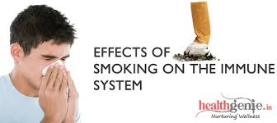
Immune system
Long-Term Effects of Tobacco Use
Chemicals in smoke reduce the activity of immune system cells.
Damaging the immune system increases the chances of suffering from diseases such as cancer.

Slide 25
Body outline
Draw an outline of a person:
Label the long term effects on the :
Mouth
Brain
Heart
Lungs
Skin
Immune system

Slide 26
Brief Information Drugs
In the U.S., Illegal drugs is a multi-billon dollar ____________________________________________________________________
Created more criminal activities that are related to drugs
Drug Smuggling is rampant coming from Central and _____________________________________________________________________
Many robberies, murders, and kidnapping are drug-related

Slide 27
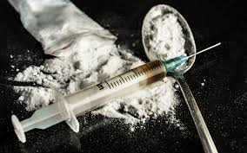
Illegal drugs
Drug abuse is the intentional improper or unsafe use of a ________________________________________________.
Drugs used for recreational purposes are called drugs of _____________________________________.
Many drugs of abuse are illegal drugs. Possessing, using, buying, or selling these drugs is illegal for people of any age.

Slide 28
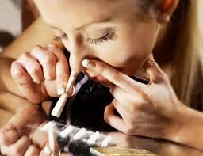
Why do we begin to use them?
a desire to experiment
a desire to escape boredom or depression
enjoyment of risk-taking behavior
a belief that drugs solve personal, social, or medical problems
peer ______________________________________________
glamorization of drugs by the ________________________________________________

Slide 29
Types of Illegal Drugs
There are many types of illegal drugs, but they all have three things in common.
They affect the function of the _________________________________________________.
They are dangerous to your ____________________________.
They can result in drug dependence and addiction.

Slide 30
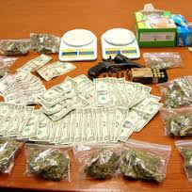
Types of illegal drugs
Marijuana
______________________________
Depressants
______________________________
Hallucinogens
Prescription drugs

Slide 31
Possession of a controlled substance
It is unlawful for any person to possess, purchase, or have under his control any controlled ________________________________________________________
PUNISHMENT
Felony 2-15 years in prison
Second Offense 5-30 years in prison

Slide 32
Sale, manufacture of controlled substances
Any person who knowingly sells, manufactures, delivers, or brings into the state different quantities of controlled substances are guilty of this ___________________________________________________________
READ SOME MANDATORY SENTENCES

Slide 33
Drug Related Objects
A person in possession of any machine, instrument, tool, equipment, or device which an average person would reasonably conclude is intended to be used for ________________________________________________
PUNISHMENT
Misdemeanor

