Slide 1
2023-2024 Family-School Compacts and Family Engagement Plan
Please view the following presentation to receive information regarding P.B. Ritch’s Family-School Compacts and our Family Engagement Plan.

Slide 2
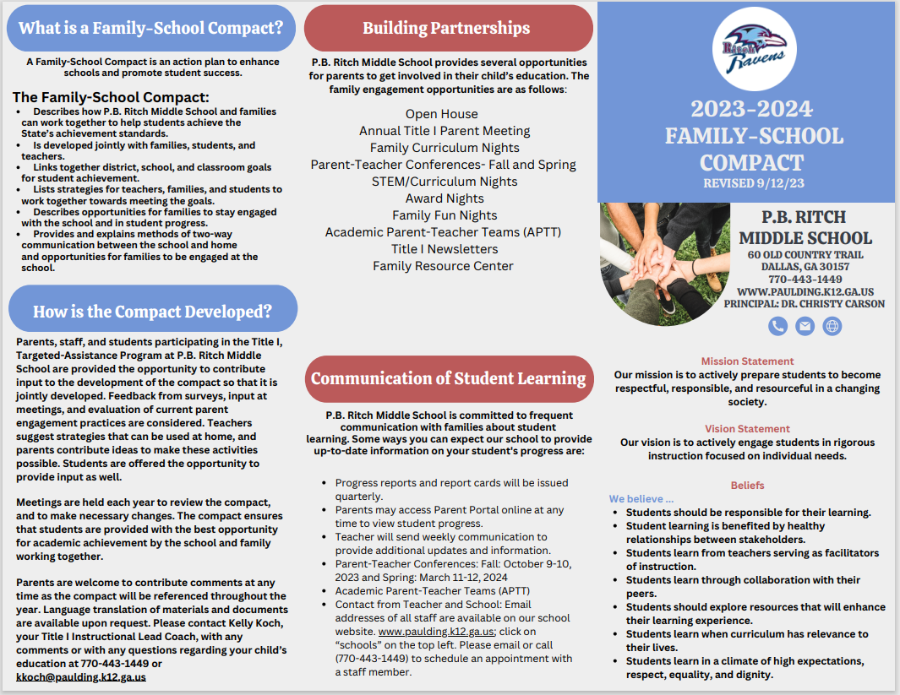
P.B. Ritch Middle School Family-School Compact
Page 1

Slide 3
P.B. Ritch Middle School Family-School Compact
Page 2

Slide 4
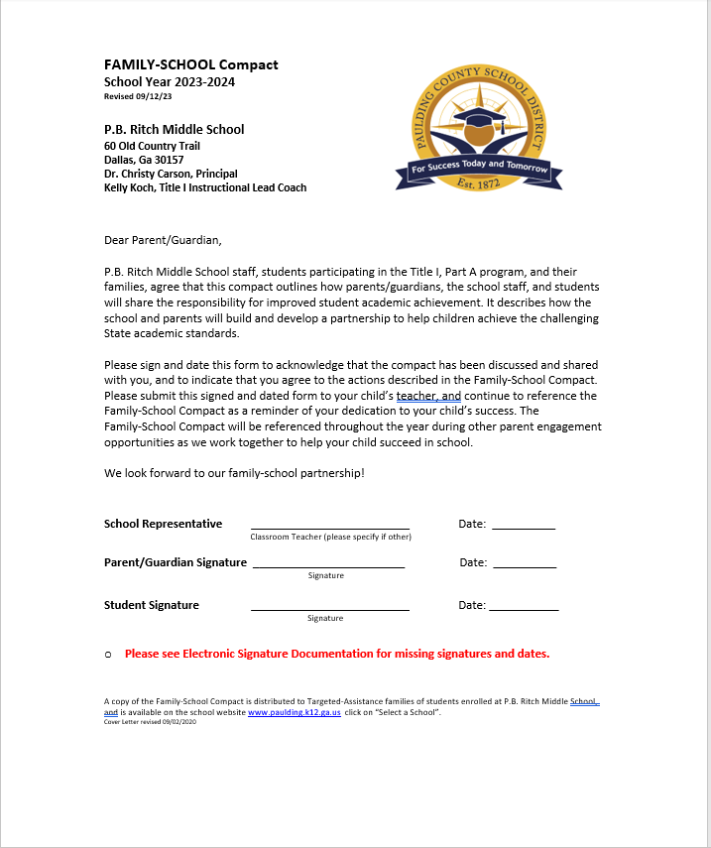
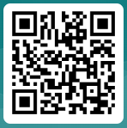
P.B. Ritch Middle School Family-School Compact
Signature Page
Please sign and have your student return this form his/her math teacher.
You may also click the link below or scan the QR code to sign electronically.
https://forms.office.com/r/gHrmjiKHuE

Slide 5
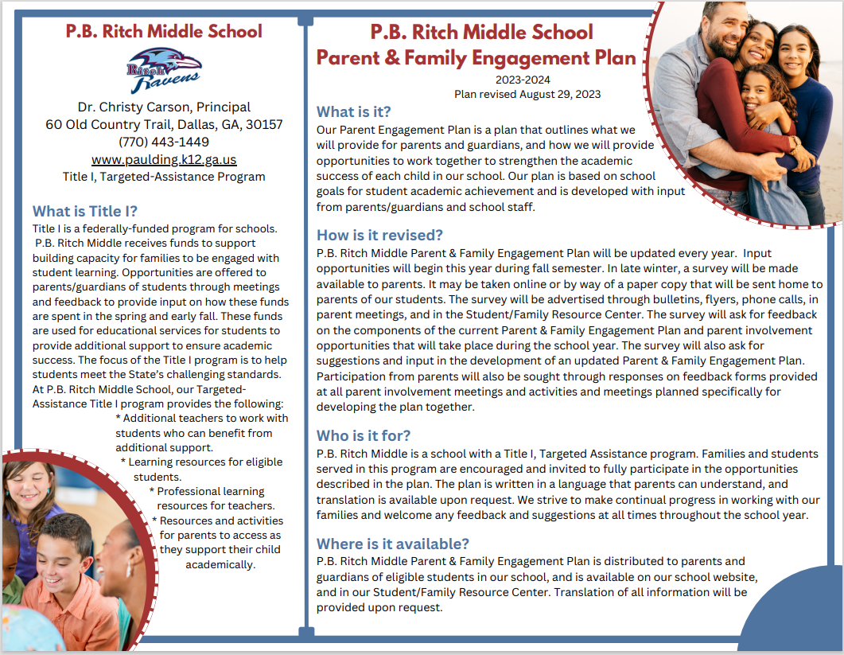
P.B. Ritch Middle School Family Engagement Plan
Page 1

Slide 6
P.B. Ritch Middle School Family Engagement Plan
Page 2

Slide 7
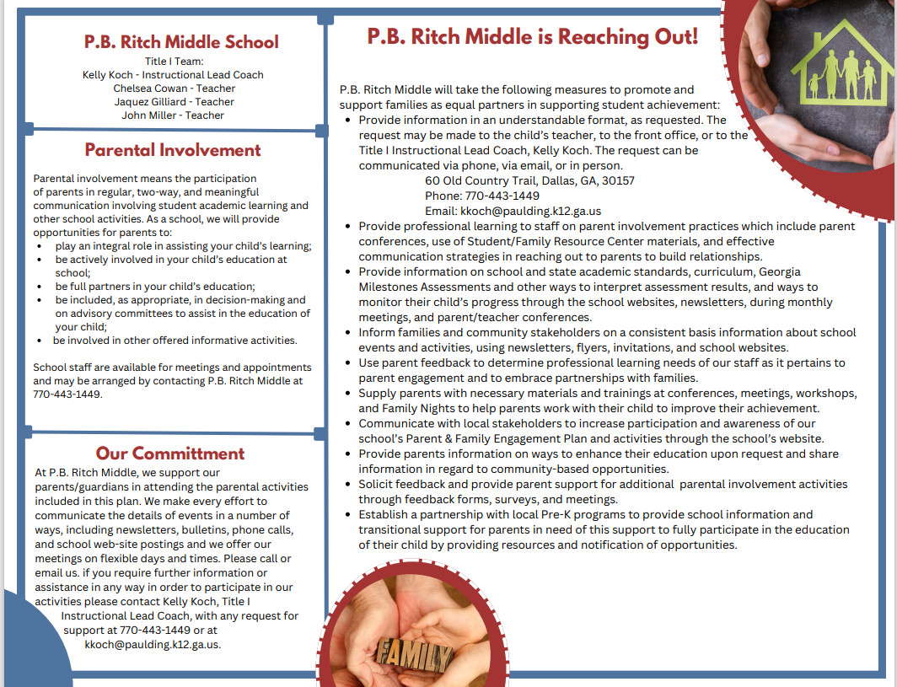
P.B. Ritch Middle School Family Engagement Plan
Page 3

Slide 8
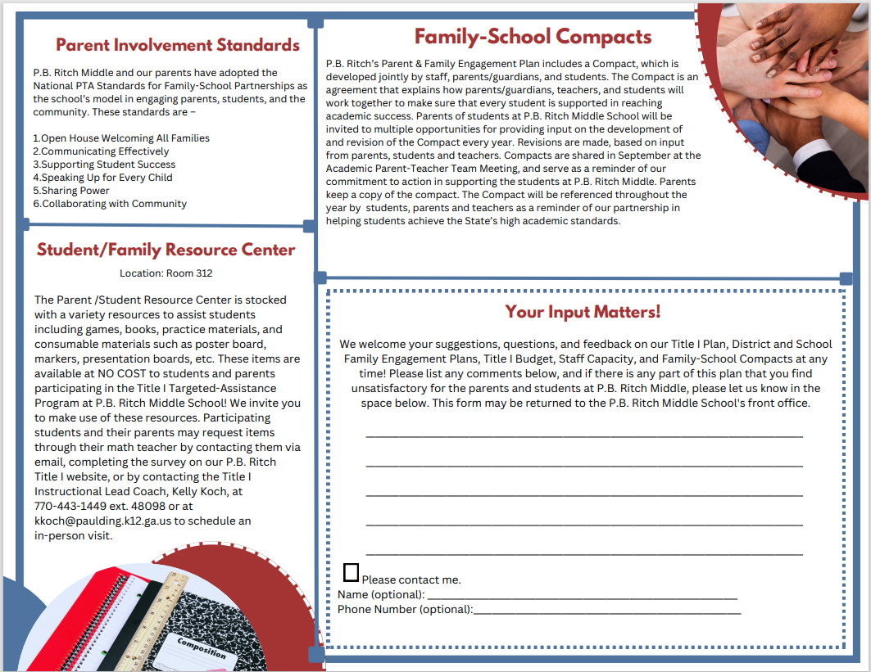
P.B. Ritch Middle School Family Engagement Plan
Page 4

Slide 9
P.B. Ritch Middle School
If you have any questions regarding our Family-School Compact or Family Engagement Plan, please contact Kelly Koch our Title I Instructional Lead Coach
kkoch@paulding.k12.ga.us
770-443-1449 ext. 48098

