Slide 1
Record and Answer the Questions in you ISN so you can review later.
1. During an experiment if you purposefully change the temperature to test a hypothesis the temperature is called the
a. Manipulated variable
b. Responding variable
c. Operational variable
d. Dependent variable
2. When doing an experiment how many variables should be tested and why?

Slide 2
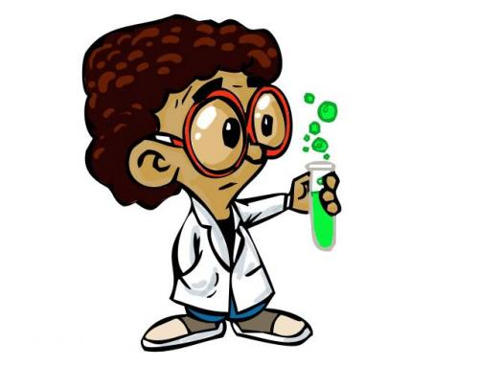
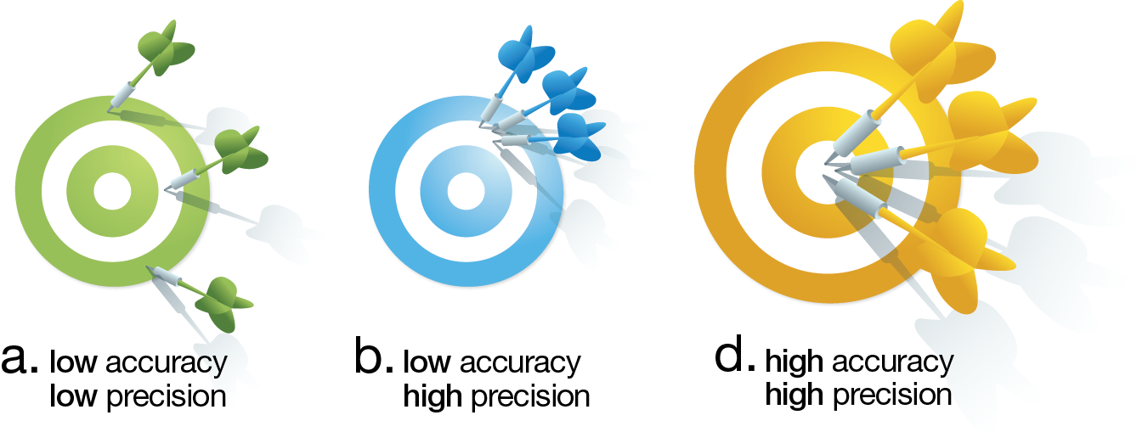
Ethics and Bias with
Experiments and Research
Accurate means a correct measurement. This is accurate if it correctly reflects the size of the item being measured.
Precise means "exact“ repeatable, reliable, getting the same measurement each time.

Slide 3

What is Bias?
A prejudiced presentation of material
A consistent error in estimating a value
An unfairly influenced presentation
What are the two main types of bias?
a) Sampling bias-is consistent error that arises due to the sample selection
b) Measurement bias-information or observation bias

Slide 4

Sampling bias is introduced when
the sample used is not representative of the population or inappropriate for the question asked. (100 people in the US or 10 kids at PB Ritch)
Measurement bias is avoided when
- Measurements taken correctly
Experiment designed to separate out the
affect of multiple factors
*We test 1 variable at a time

Slide 5
Factors that could lead to sample bias:
SAMPLE SIZE: Is the sample big enough to get a good average value?
Is the sample 1% of the population or 10%?
SELECTION OF SAMPLE: Does the composition of the sample reflect the composition of the population?
IS there a variation in the sample like there is in the population. Boys and girls at a school or a comparison of a metal and non-metal instead of two metals

Slide 6
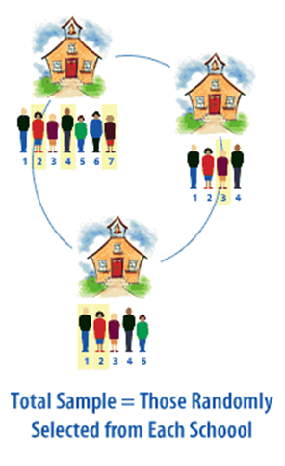
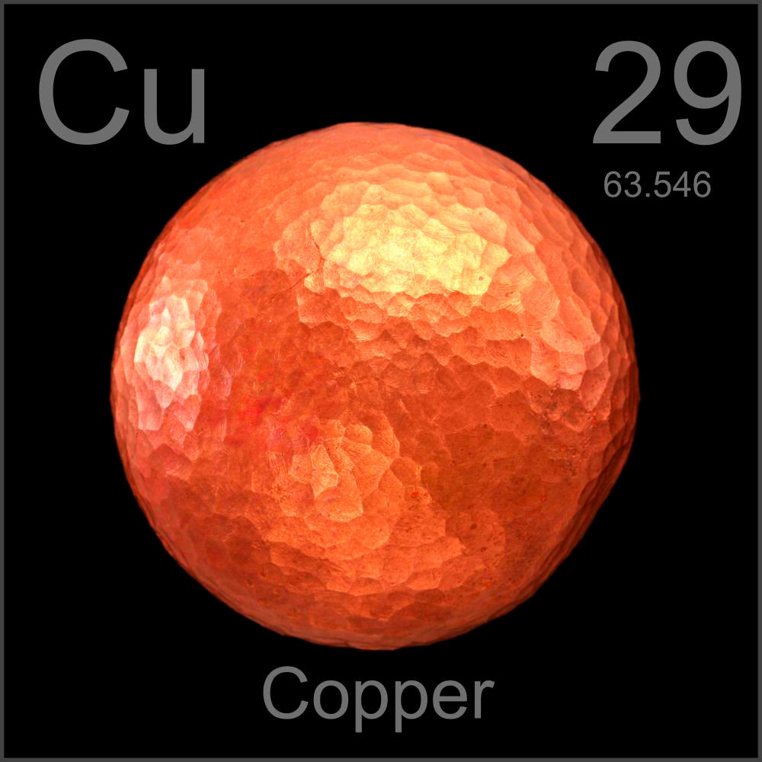
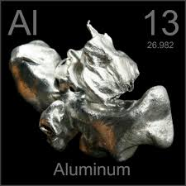
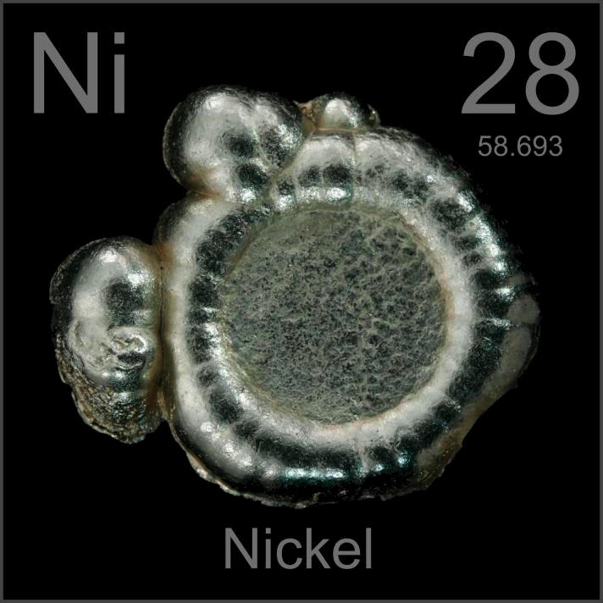
What are some ways to minimize sampling bias?
1.Use a RANDOM SAMPLE = Every sample has an
equal likelihood of being chosen.
2. Limiting the question asked to the specific group
sampled.
Ex: Are all the metals in the same family, or are
they slightly different families?

Slide 7
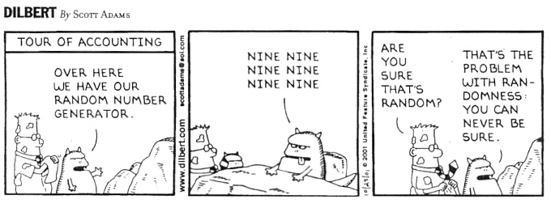
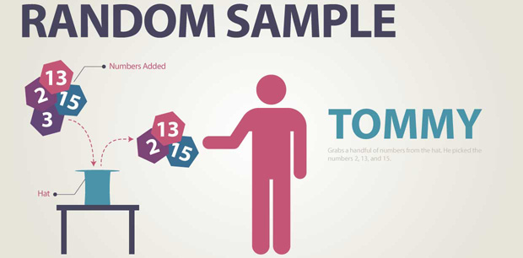
Think, Think, Think….

Slide 8
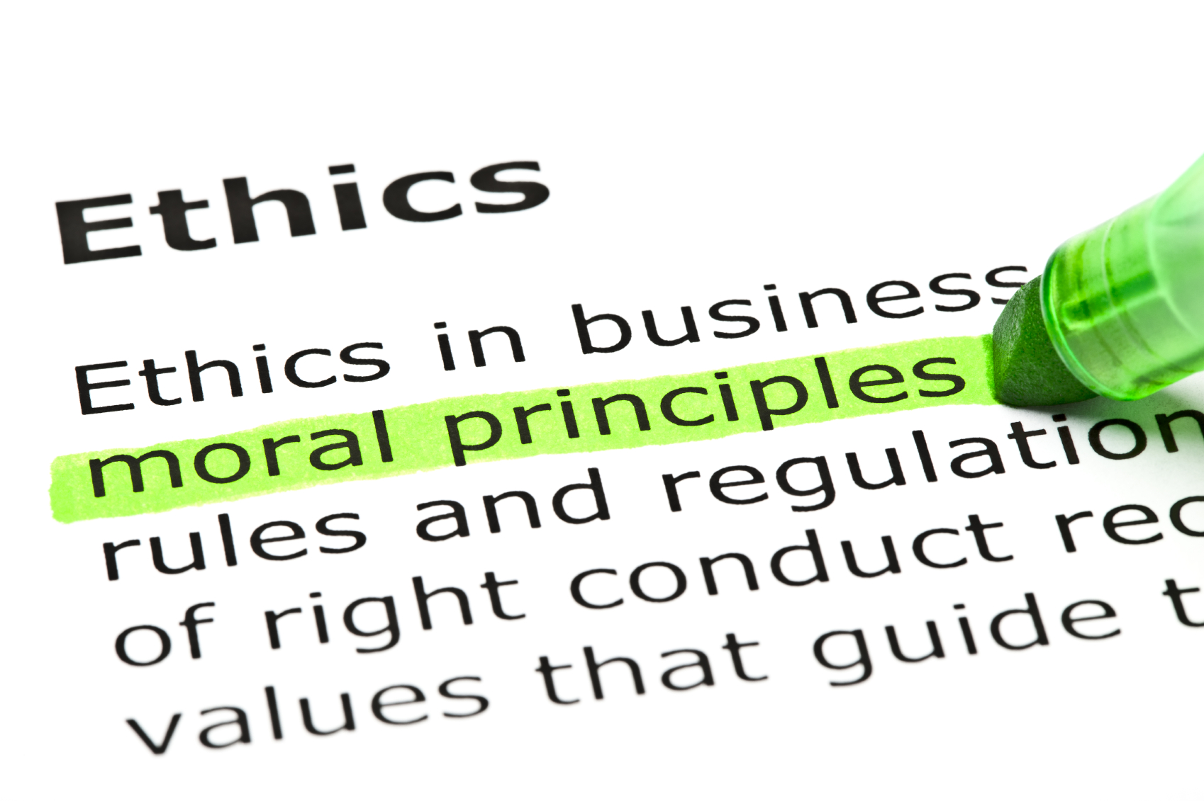
Ethics
Why it is important to adhere to ethical norms in research?
promote the aims of research
values that are essential to collaborative work
accountable to the public
build public support for research
moral and social values

Slide 9
Study for Test!!
How do I know if I am prepared?
Can you…
Explain and breakdown the Scientific Method?
Apply the Scientific Method to an example?
Explain the most important safety rules?
Breakdown an experiments Independent Variables and Dependent Variables? And then graph data from an experiment?
Identify a control?
Recognize and explain Bias in an experiment?
Explain the impact of bias and ethics in science and scientific research?

