Slide 1
August 5th 2016
RIGHT NOW
Please get out a pencil/pen your notebook, folder, and any signed forms.
Before class begins write down what the focus of our work time today is as well as your homework.
WT: Lab Safety and Scientific Method
HW: Create a lab safety poster/meme/slogan to encourage proper safety protocols in a lab.
Warm Up
What is the independent Variable?
What is the dependent Variable?
I will be able to:
explain the process that scientific method uses as well as the safety protocols that are necessary to operating in a science lab.

Slide 2
AUGUST 5th 2016
Independent & Dependent Variables

Slide 3
Can you explain how the cartoon above relates to science? Application: Give examples of each step of the Scientific Method from the cartoon.

Slide 4
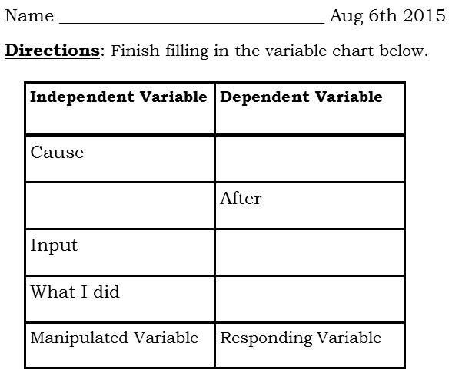
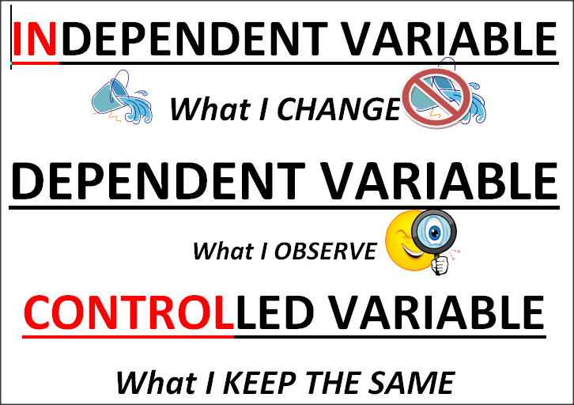
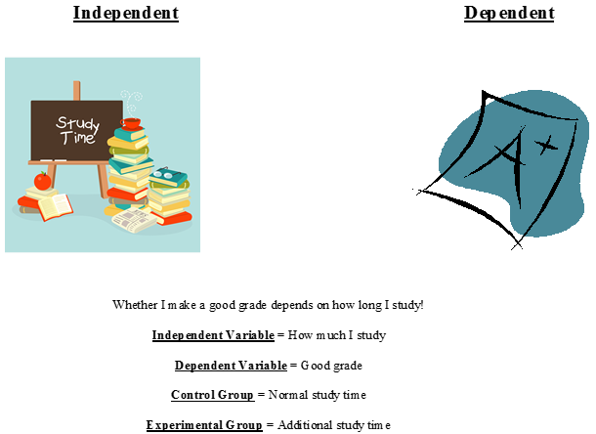

Slide 6
NOW we are going to apply the variables to a graph so that changes can be more easily observed.
USE DRY/MIX to help set up your graph.

Slide 7
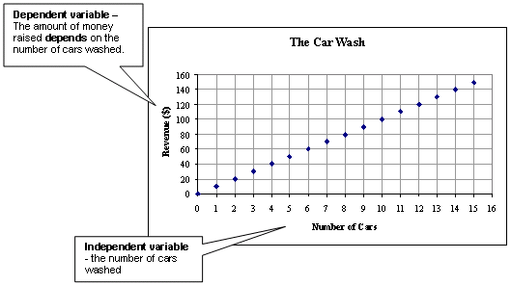
Example 1:

Slide 8
Example 2:

